Slide 1
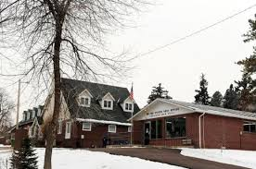
The Early Years – Growing Up
Louviers, Colorado
Population (1990) – 300
Elevation – 5669 ft
Built in 1906 by the DuPont Company to make TNT
Graduated from Douglas County High School (10-12) in 1991
Enrollment (1991) – 842
Umpired Baseball from age 16-21
Worked over 600 games at little league and high school level

Slide 2
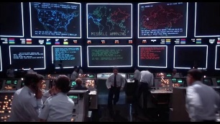
College and Military – Moving Up, Moving Out
Graduated from Embry-Riddle Aeronautical University in 1995
4-year Air Force ROTC Scholarship
Degree in Aviation Computer Science
Active Duty U.S. Air Force 1995-1999
Served as a communications officer (Software Engineer) at U.S. Strategic Command, Offutt AFB, Nebraska
Spent a lot of time underground working on CCPDS-R (real-life version of the WOPR in WarGames)
It was cold

Slide 3
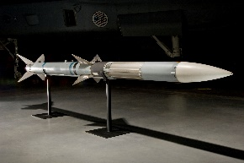
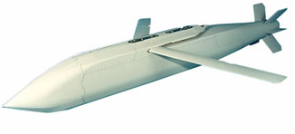
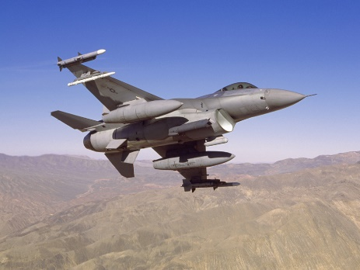
Raytheon – Climbing the Corp Ladder
Worked for Raytheon Missile Systems 1999-2019
Software Engineer
International AMRAAM, HARM Targeting System, JSOW
Earned MBA degree from UofA
Program and Functional Manager
Active Protection System
Program Planning and Scheduling
Global Trade
Retired as Senior Program Manager (executive level)

Slide 4
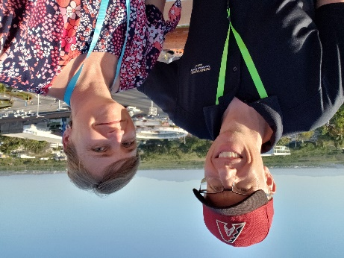
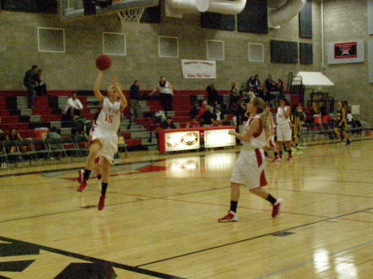
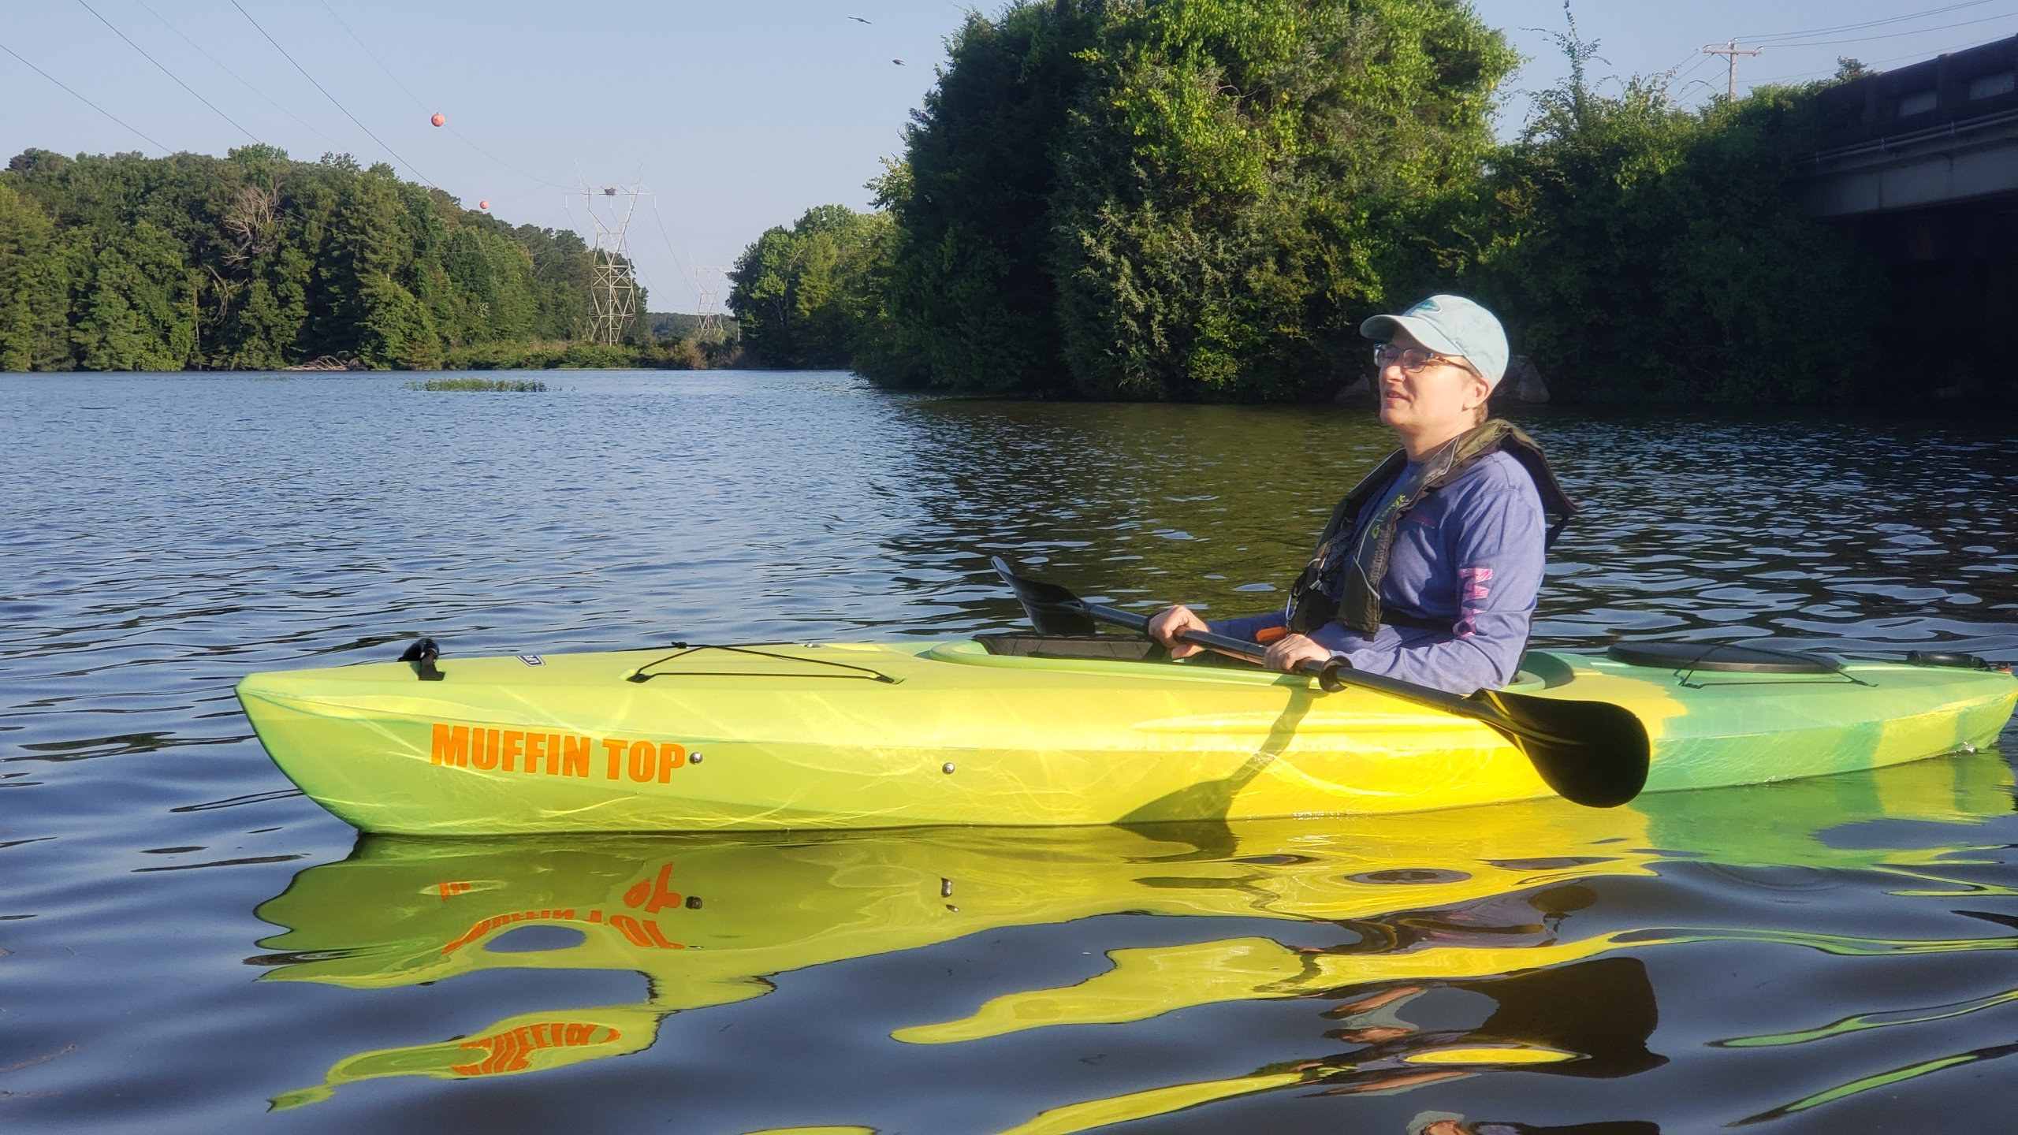
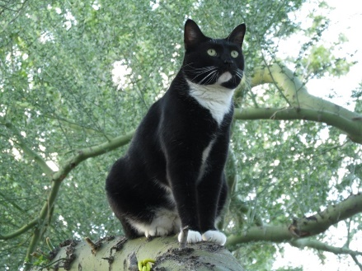
Teaching and Personal – Transitions
UofA TeachArizona Program
2020-2021 – Taught Econ and Government at Catalina Foothills High School in Tucson, Arizona
Married in 1994 – Ellen
Has online business designing knitting patterns
Daughter in 1997 – Kate
Graduated from ASU in 2018
Cat from 2014 to ? - Dobby

Slide 5
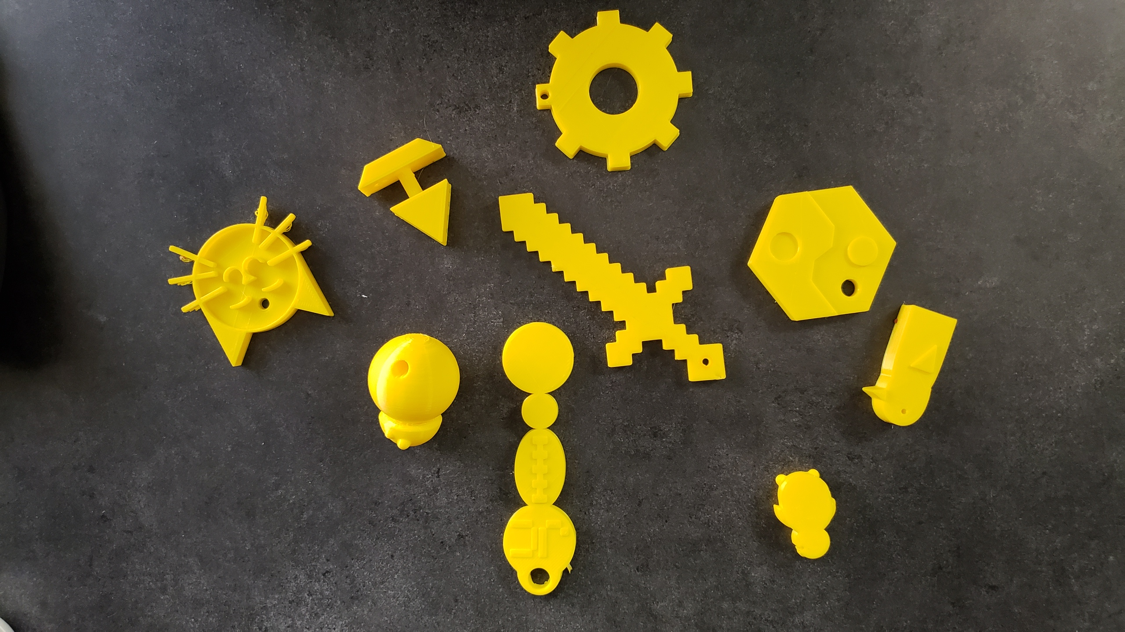
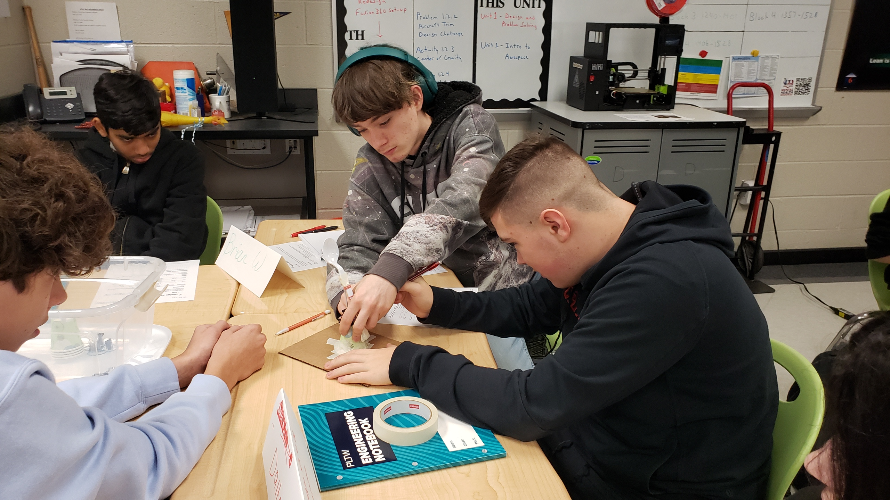
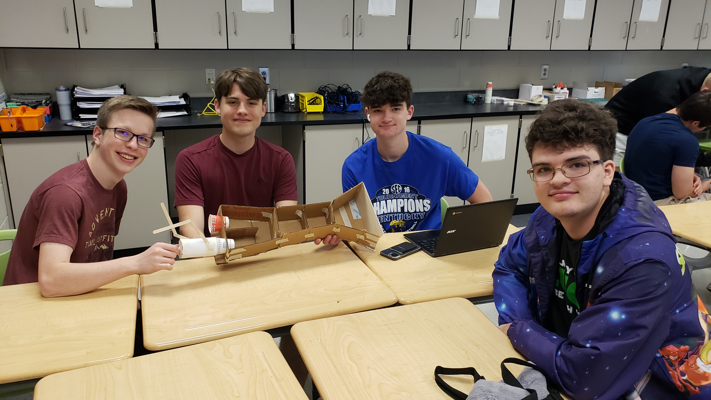
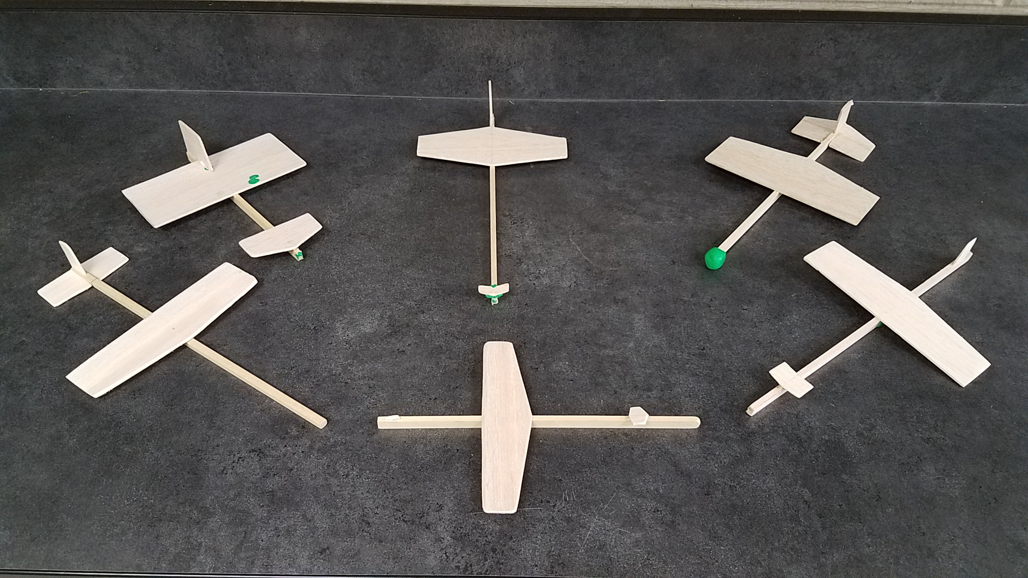
Teaching and Personal – JCHS
Teaching Intro to Engineering Design and Aerospace Engineering
National Honor Society Advisor

